Slide 1
Sketch-Guided Text-to-Image Diffusion Models
20200249 Sehun Park
20180389 Geon-Gyu Oh

Slide 2
Table of Context
Prerequisite
  Generative Adversarial Network
  Image-to-Image Translation
  Diffusion Models
Method that the paper used
  Latent Edge Predictor
  Sketch-Guided Text-to-Image Synthesis
Experiment
  introduction of the experiments
  result

Slide 3
Prerequisite
GaN(Generative Adversarial Network)
Image-to-Image Translation
SketckyGaN
Contextual GaN, CoGS
Diffusion Models
DDPM, ILVR, SDEdit
Make-a-Scene, eDiffi

Slide 4
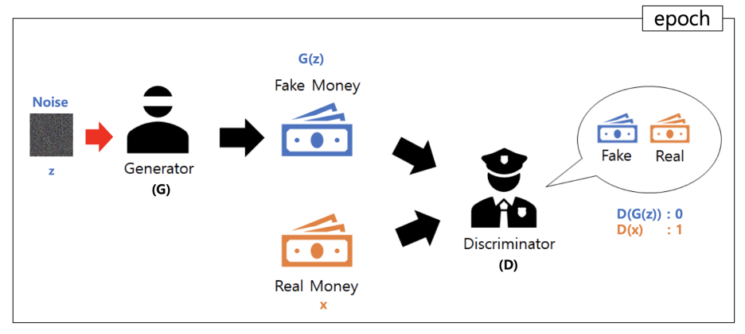
GaN(Generative Adversarial Network)
https://m.blog.naver.com/euleekwon/221557899873

Slide 5
Image-to-Image Translation
Image-to-image translation has been a long-standing task in computer vision domain.
One common architecture which becomes the solution : Conditional generative adversarial networks
  methods tackle each task independently and use task-specific datasets and models

Slide 6
Image-to-Image Translation
Special Case of Image-to-image translation: task of sketch-to-photo task
  SketckyGaN
    uses edge-preserving image augmentations to train GAN

Slide 7
Image-to-Image Translation
Special Case of Image-to-image translation: task of sketch-to-photo task
  Contextual GaN
    leverages conditional GAN with joint image-sketch representations
  CoGS
    minimize the distance of the embedding of the input sketch and the corresponding ground truth real image

Slide 8
Diffusion Models
DDPM
  introduced unprecedented quality of conditional and unconditional image synthesis
ILVR
  proposes to iteratively refine the diffusion process using a noisy reference image
SDEdit
  Suggests to add noise to the input guiding image

Slide 9
Diffusion Models
Make-a-Scene, eDiffi
  introduced unprecedented quality of conditional and unconditional image synthesis

Slide 10
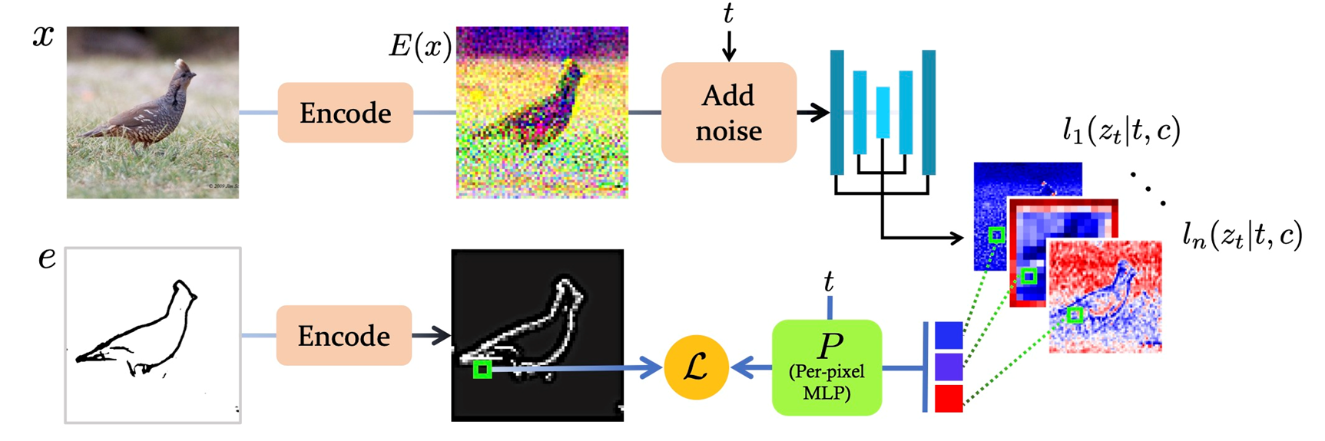
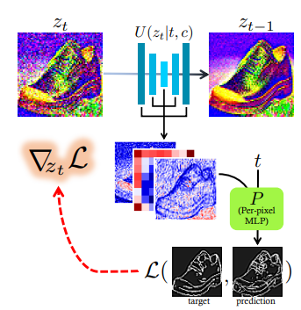
Method that Paper used
Latent Edge Predictor
Sketch-Guided Text-to-Image Synthesis

Slide 11
2.a - Latent Edge Predictor

Slide 12
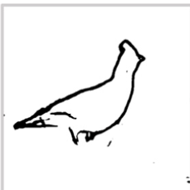
2.a - Latent Edge Predictor
Training corpus D is formed by the triplets (x,e,c) of an image, edge map, and a corresponding text caption.
We use the encoder E to preprocess the images and the edge maps
Input tensor is the encoded image with additive gaussian noise
Edge map
  an image that indicated where edges are in the image.

Slide 13

2.a - Latent Edge Predictor
MLP is the trained to map the internal activations of a denoising diffusion model network into spatial edge maps
Training objective of our latent edge predictor P is
For every spatial position (i,j) F(zt | c,t)i,j is translated to E(e)i,j
  F(zt | c,t)i,j = latent pixel at spatial position (i, j)
  E(e)i,j = latent edge at spatial position (i,j)

Slide 14
2.b - Sketch-Guided Text-to-Image Synthesis
Generates image based on sketch e with a caption c
Start from latent image representation sampled from a uniform Gaussian
Concatenate the intermediate activations to a per-pixel tensor F(zt | c,t)i,j Then use the pre-trained per-pixel

Slide 15
2.b - Sketch-Guided Text-to-Image Synthesis
Evaluate the anti-gradient(-∇zt ℒ) to to bring the edges-guidance to the diffusion process
  ℒ: similarity between the current prediction and truth value
  Ē: estimation of E

Slide 16
2.b - Sketch-Guided Text-to-Image Synthesis
Concatenate the intermediate activations to a per-pixel tensor Then use the pretrained per-pixel
Evaluate the anti-gradient to bring the edges-guidance to the diffusion process

Slide 17
2.b - Sketch-Guided Text-to-Image Synthesis
In practice the final steps of the reverse denoising process commonly do not affect the geometric layout of the final generated image.
We perform the edge guidance only for the steps t = T, … ,S > 1
  Commonly S = 0.5T

Slide 18

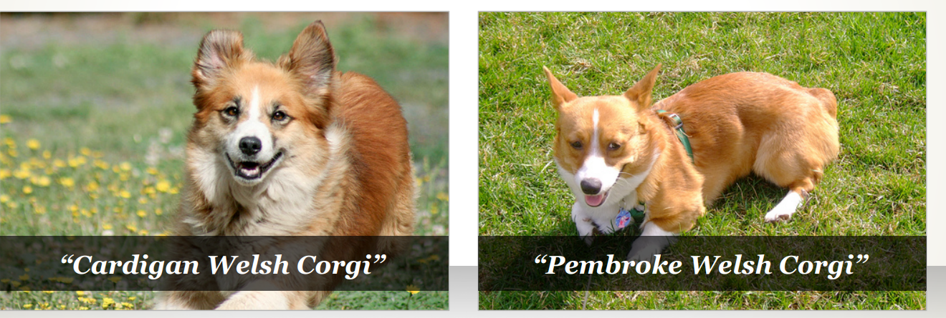
Implementation
Sample: Imagenet(class names & captions)
ImageNet: Where have we been? Where are we going? by LIFEI – FEI & JIA DING

Slide 19
Implementation
Edge maps
  edge prediction model with threshold of 0.5
Latent edge predictor
  4 fully-connected layers
    batch normalization
    ReLU activation
    hidden dimensions : 512, 256, 128, 64
    output dimensions : 4

Slide 20
Implementation
Denoising model
  9 different layer across the network
    input block : layers 2,4,8
    middle block : layers 0, 1, 2
    output block : layers 2, 4, 8
Training
  Performed for 3000 steps in Adam optimizer
  Batch size = 16 (Takes less than hour in single A100 GPU)

Slide 21
Implementation
parameters for Inference
  β = 1.6
    β : edge guidance scale
  S = 0.5T
    S : guidance stop step
    T : number of denoising steps
  prompt-conditioning = 8
    prompt-conditioning : Classifier-free guidance scale in DDPm

Slide 22
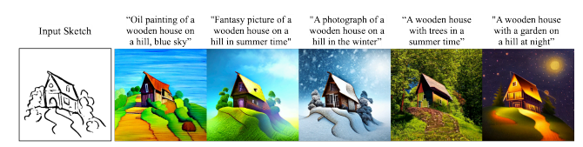
Result

Slide 23
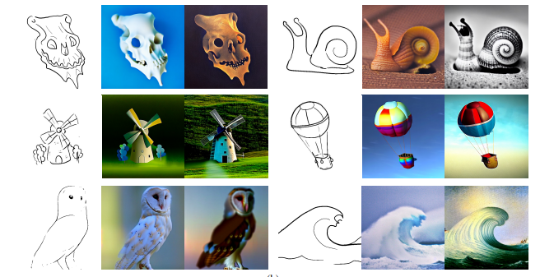
Result
Notes:
As a result, the sketch-guided text-to image framework follows well the order of input texts. The results applied with different seeds and captions. It can be seen that our approach successfully handles objects from different domains. The corresponding captions as well as more results can be found in the supplementary material. And as you can see, the framework follows well for different art style of hand-drawn sketches from simple doodle to complicated ones.

Slide 24
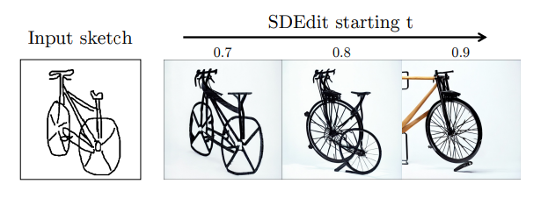
VS SDEdit
Diffusion model with sketch
The degree of inserted noise, t decides the generated image’s style
  Higher t makes image more realistic
  Lower t makes image more faithful
Notes:
The authors of this paper compared this with three baseline approaches: SDEdit, pix2pix, and PITI.

Slide 25
VS SDEdit
Both t size have a problem
  Higher t decreases the fidelity to the input sketch
  Lower t struggles to add texture in the output
Notes:
However, SDEdit has a drawback about generating image from sketch, and it is unable to overcome whether you select a proper t value. If you select high t value, then it decreases the fidelity to the input sketch. However, if you want to change lower t value in order to save fidelity, then SDEdit struggles to add texture in the output, and the image does not looks like realistic. As you can see, the result with higher value does not reflect the whole input sketch and follows only right half of original one, and the result with lower t value just mimics original input sketch.

Slide 26
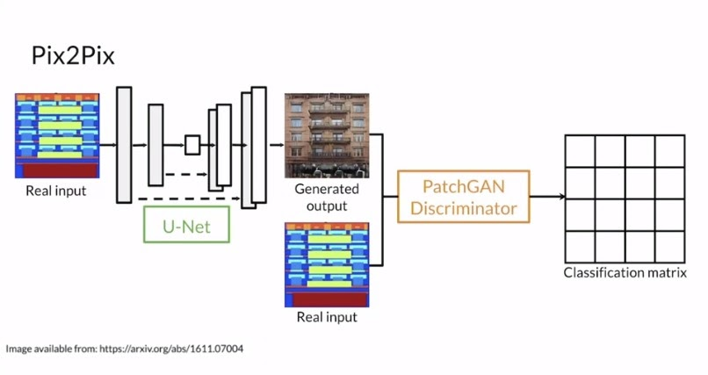
VS pix2pix
Pix2pix
  Based on CGAN
  Self-supervised method, trained on pairs of images
Notes:
The second method which the authors selected to control group is pix2pix.
Pix2pix is a self-supervised method which is variation of cGAN, which added paired image-to image translation to cGAN.
Pix2pix does not used noise vector at generator. Instead, they used U-net generator.
As a result, the discriminator of Pix2pix, which called as ‘patchgan’, generates the matrix contains tensor value of predicted probabiliites.

Slide 27
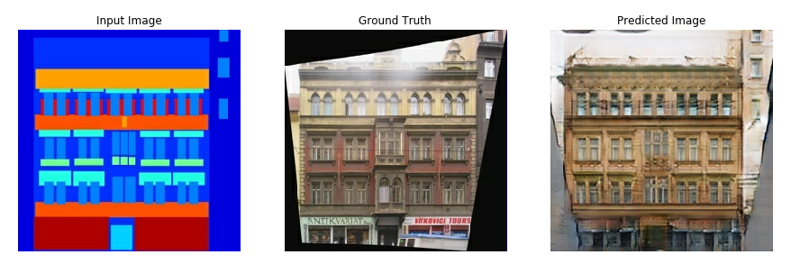
VS pix2pix

Slide 28
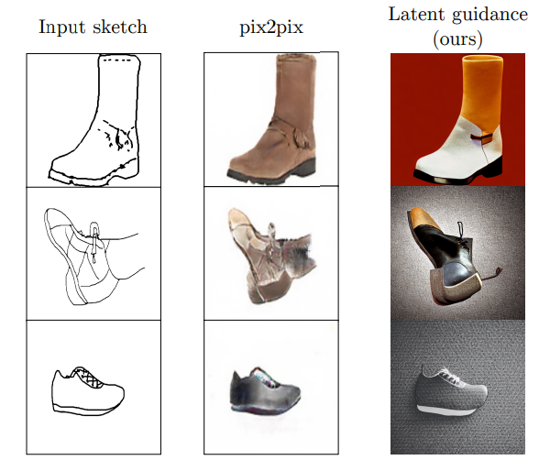
VS pix2pix
  Works well only on sketches lay within the domain of training data
  Fails on out-of domain, hand-drawn sketches
https://affinelayer.com/pixsrv/
Notes:
But pix2pix has a problem about handeling lower-detailed doodles. It only makes image well when the input sketch is realistic. It is because pix2pix works well only sketches lay within the domain of training data.

Slide 29
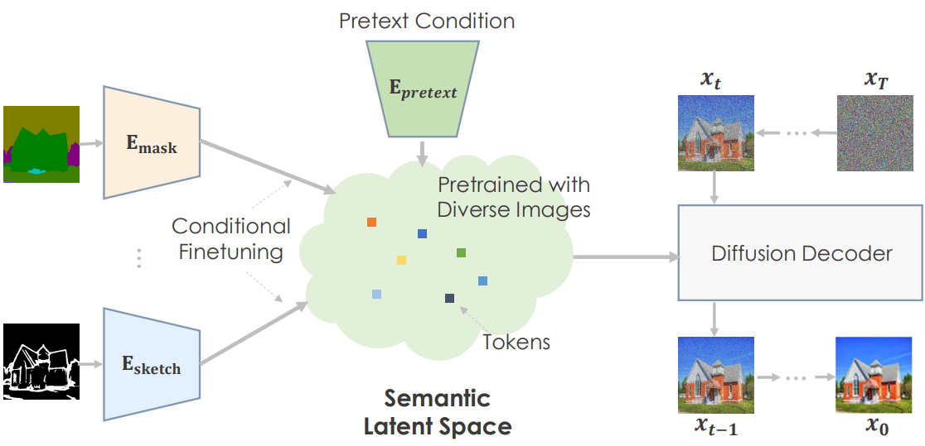
VS PITI(Pretraining is All You Need for Image-to Image Translation)
Trains a dedicated encoder to map the guiding image into the latent space of the pretrained unconditional diffusion model
Uses 2-level fine-tuning
  1st: Train encoder by task
  2nd: Train both
Notes:
The last one is PITI. PITI is a image-to image translation using downstream method. It trains a dedicated encoder to map the guiding image into the latent space of the pretrained unconditional diffusion model. And it fine-tuning 2 times: the first training is only for encoder, and the second training is for both - encoder & decoder.

Slide 30
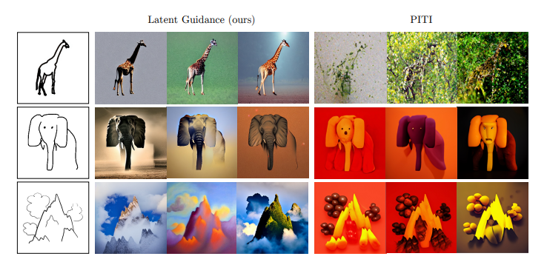
VS PITI(Pretraining is All You Need for Image-to Image Translation)
PITI’s weakness: Free-hand sketches
  Reason: the lack of training data domain
Notes:
However, as you can see from second image of elephant and third image of mountain, the PITI struggles to create realistic outputs on free-hand sketches, which is out of training data domain.

Slide 31
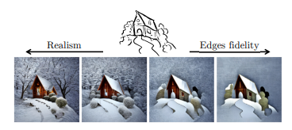
Ablations and Parameter Tuning
Trade-off by edge guide scale β
  Larger β: More realistic image with detail
  Smaller β: Favored edge alignment
Notes:
For ablations and parameter tuning,
The trade-off, which can be controlled by the edge-guidance scale β. For small values of β, we get a more realistic image with details and textures that cover regions in the entire image, while the larger value of β favors edge alignment but generates less realistic, piece-wise smooth ones.

Slide 32
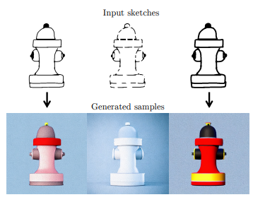
Ablations and Parameter Tuning
Different stroke style makes different result
Notes:
In addition, the researchers found that the same sketch geometry but with different stroke styles may generate different result about art styles.This picture shows that such a setting yields the same shape, but with variation in colors and textures. This observation explains that the stroke style affects the inner synthesis process only, which accumulates into varying colors of the output image.

Slide 33
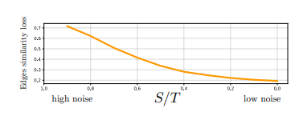
Ablations and Parameter Tuning
Edge-Fidelity
  Higher guidance stop step guarantees low loss
  But high edge-fidelity may harm realistic details
Notes:
This is the result of the measurement of edge-fidelity. The edge-fidelity is the MSE btw the target edge map and the edges of the synthesized image, and the result is a function of the guidance stop step S. As expected, the quality of edge reconstruction is improved for larger values of S.

Slide 34
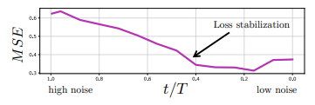
Ablations and Parameter Tuning
Reconstruction Error
  Calculate MSE about various t values
  The error stabilized when t=0.5T
Notes:
And this is the graph of Reconstruction Error of the Latent Edge Predictor. This measurement is for finding sweet spot of balancing realism and quality. While starting from half of T, the MSE value stabilized at t was smaller than half of original value.

Slide 35
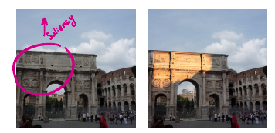
Application: Saliency Guidance
  Saliency map can specify text-to-image diffusion’s saliency in specific areas
  In this case, the predictor trained to directly predict the original saliency
Notes:
This spatially-guided, text-to image synthesis can be used at various ways. One example is saliency guidance. This model is able to use to detect the most attention grabbing regions within an image.
For example, if the user selects particular position of original image and set the saliency high, then the sketch-guided text-to image model makes the highlight for that point.

Slide 36
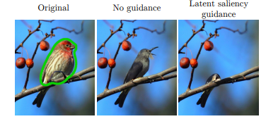
Application: Saliency Guidance
  The model fills the mask by using foreground subjects based on the semantic hints provided in the non-masked regions
    In this case, the image filled with another bird’s image
Notes:
This is another way of applying saliency guidance. The following picture of bird shows the difference of applying saliency guidance. In this case, saliency guidance enables to referencing background data. In ordinary way, the framework draws the new bird on the mask’s point.

Slide 37
Application: Saliency Guidance
  If low saliency value is given to the guiding map, the model fills the mask with background values
Notes:
But if we apply low saliency, the system can erase bird and fill the blank with background image’s data.

Slide 38
Quiz
What is the model which introduced unprecedented quality of conditional and unconditional image synthesis?
  eDiffi
  Make-a-Scene
  ILVR
  SDEdit
  DDPM
Which model has the highest risk of ignoring input hand-drawn sketch’s shape?

Slide 40
Reference
[1] Sketch-Guided Text-to-Image Diffusion Models by Andrey Voynov, Kfir Aberman, Daniel Cohen-Or
[2] ImageNet: Where have we been? Where are we going? by LIFEI – FEI & JIA DING
[3] Sdedit: Image synthesis and editing with stochastic differential equations
[4] Image-to-image translation with conditional adversarial networks
[5]

